Slide 1


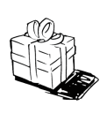

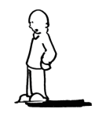
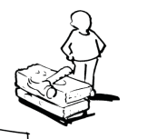
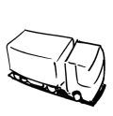
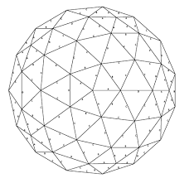

Technology-Product Model -
Problem List Top 3 Problems 1. 2. 3. | Idea Current Idea CrowdIO Crowd Size Analytics using crowd audio/noise | Value Propositions Hi-level concepts |  | End User engagement Address stickiness for the solution | End user Segments
 | Key Activities / Resources |  |  | Technology Delivery Channels Can be blank
Architectural Pattern |  |  | Interfaces

Slide 2
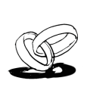
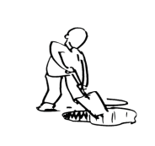

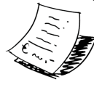
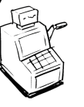

Business Model Canvas -
Key Partners | Key Activities | Value Propositions |  | Customer Relationships | Customer Segments
 | Key Resources |  |  | Channels
Cost Structure |  |  | Revenue Streams
Social & Environmental Cost |  |  | Social & Environmental Benefit

